Slide 1
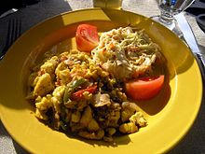
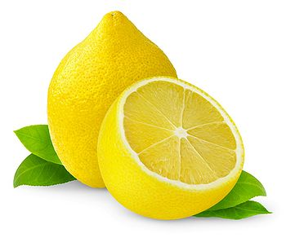
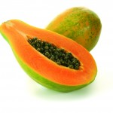
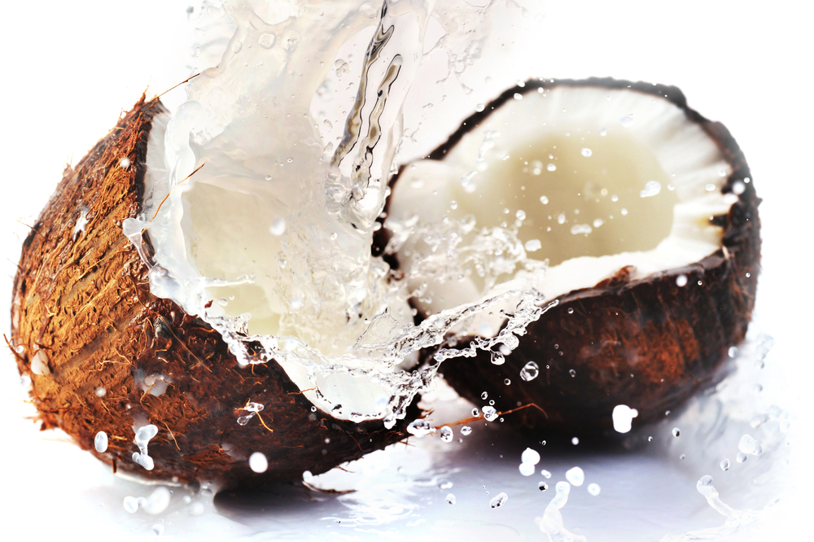
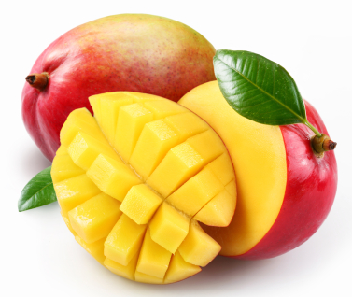
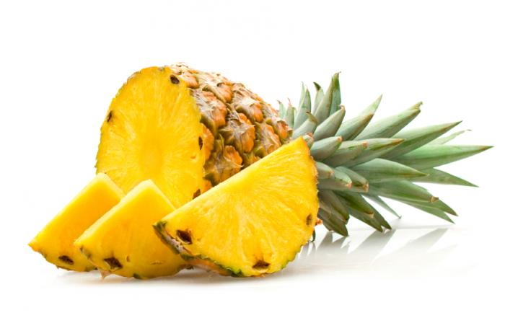
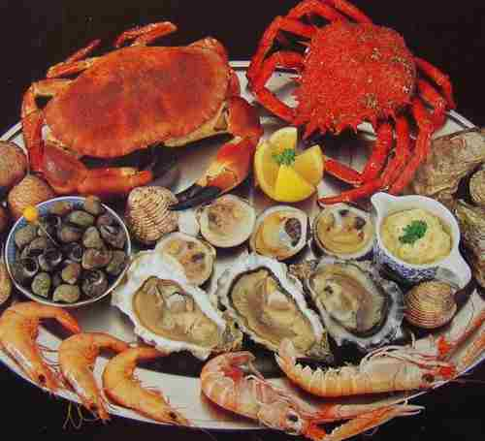
FOOD, FRUITS, VEGETABLE AND SIDE DISHES IN JAMAICA.
BY: TAYLOR FAIRBANKS

Slide 2
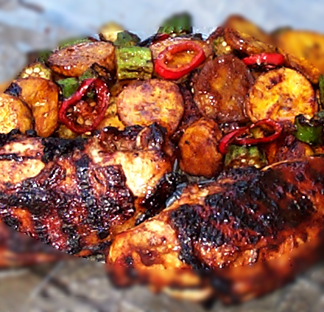
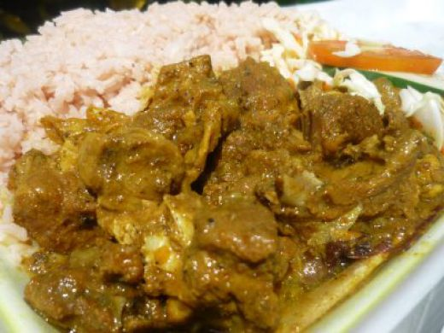
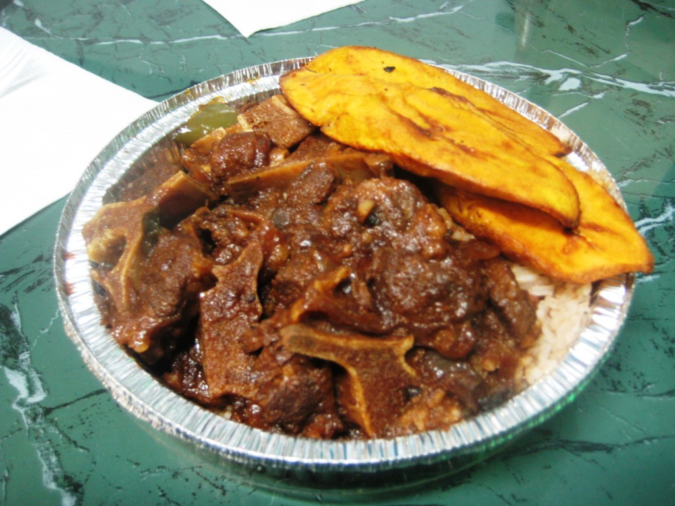
MEATS
CHICKEN
GOAT
OXTAILS
SEAFOOD

Slide 3
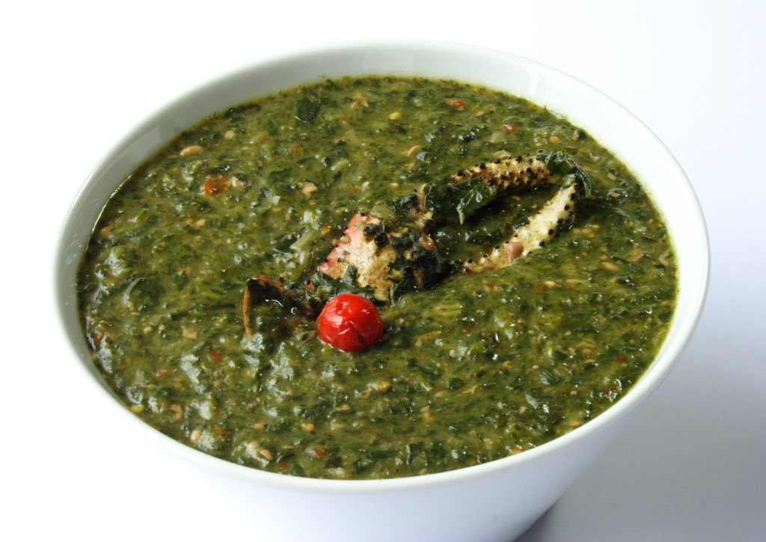
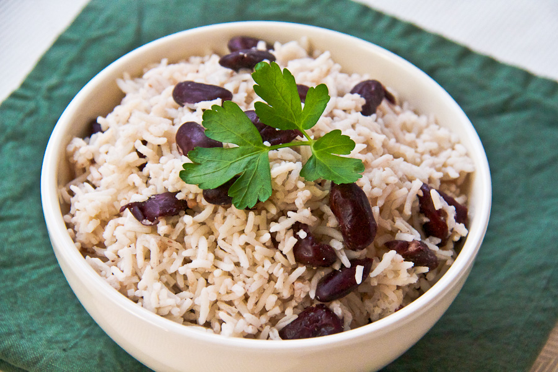
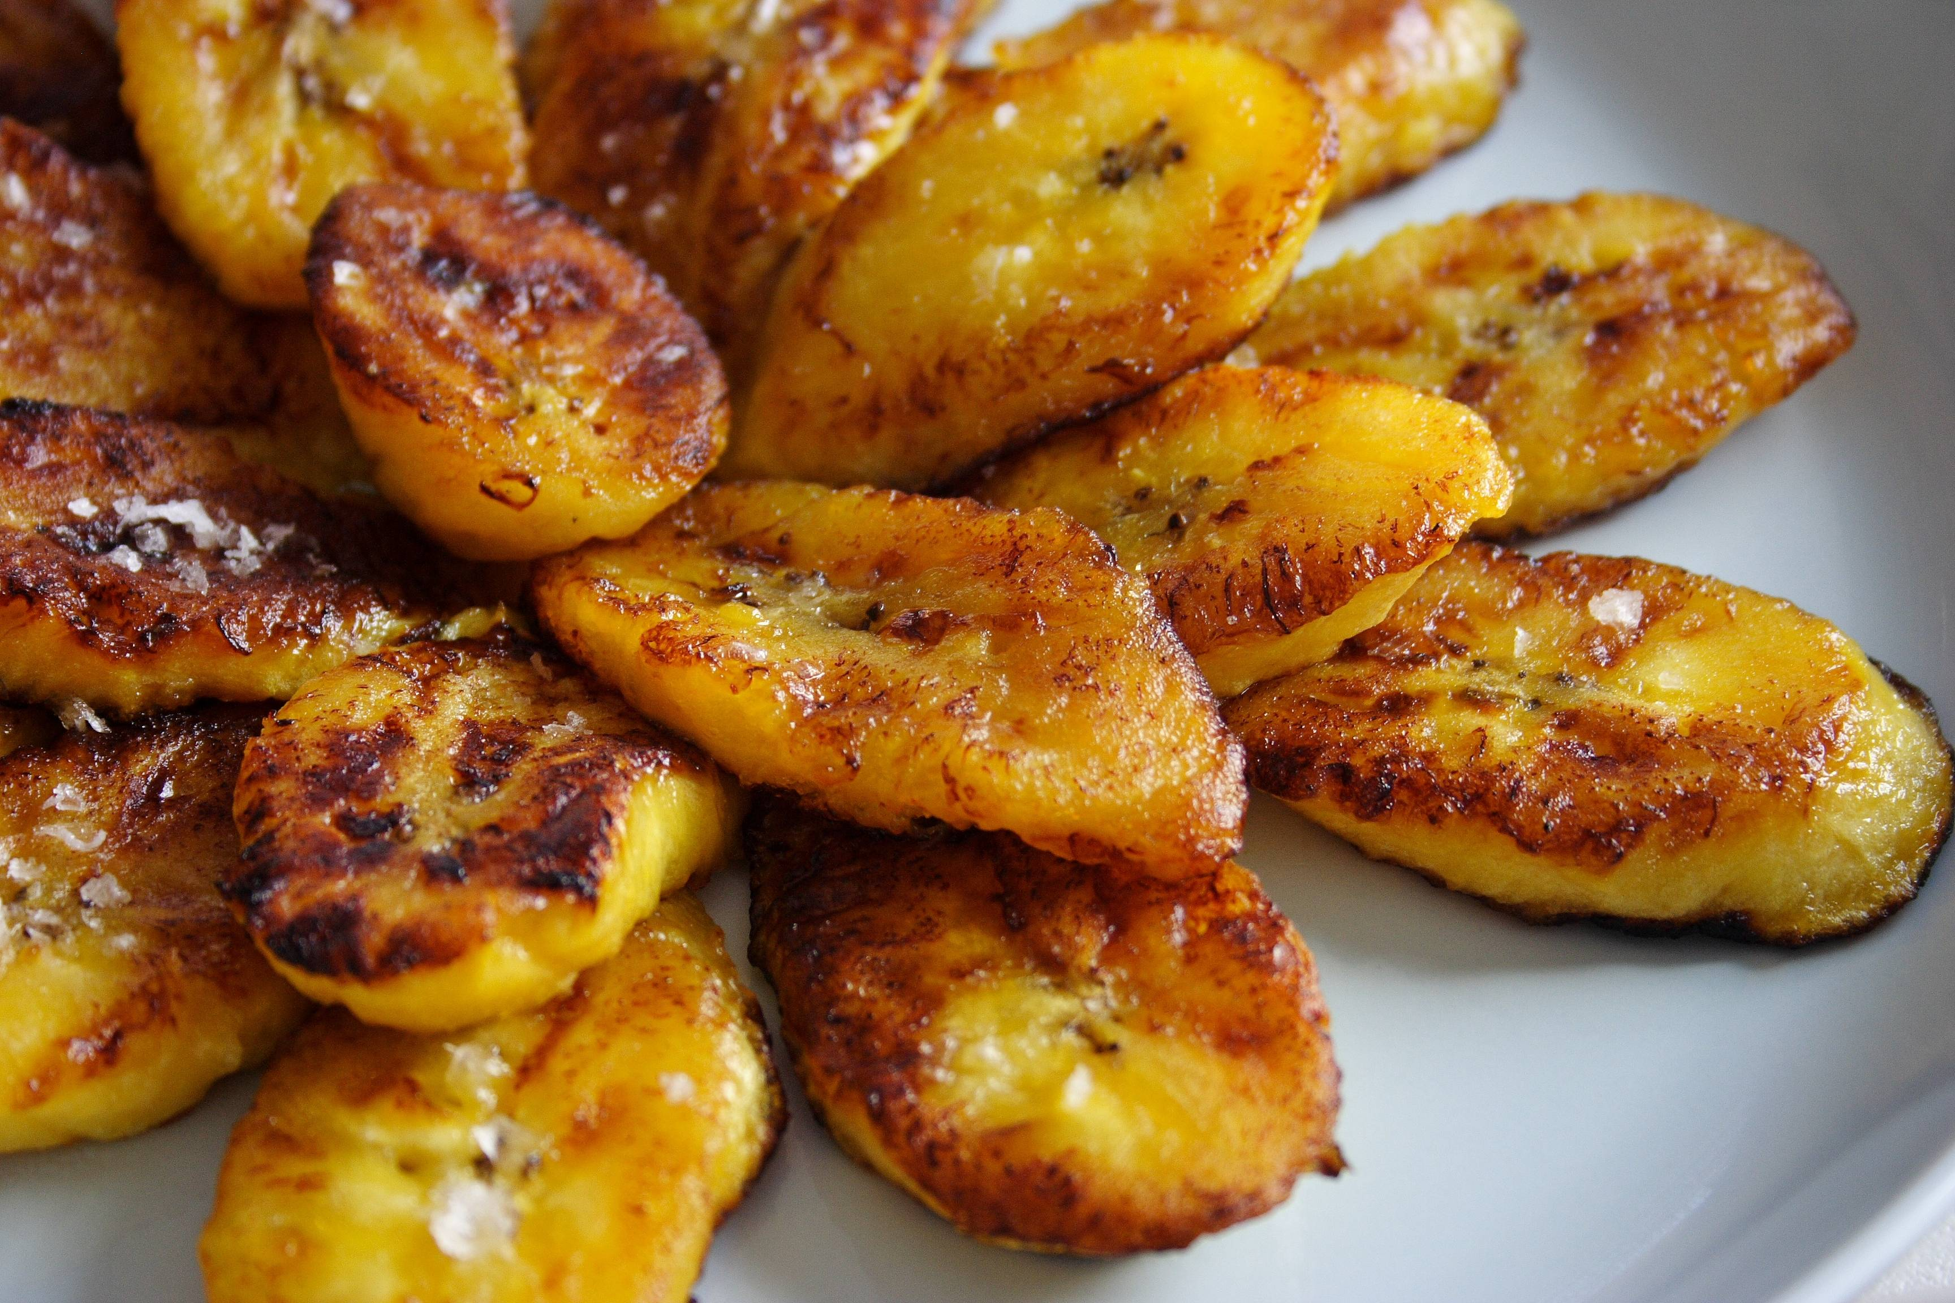
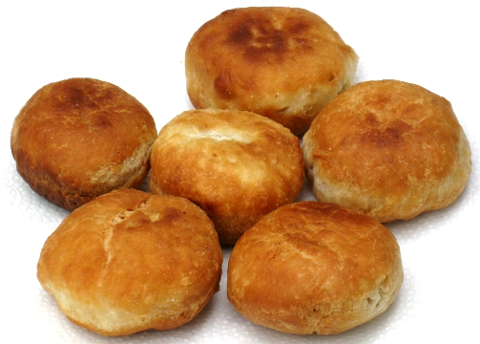
VEGETABLES AND SIDE DISHES
CALLALOO
RICE AND PEAS
PLAINTAINS
DUMPLINGS

Slide 4
FRUITS IN JAMAICAS TROPICAL CLIMATE
PINEAPPLE
MANGOES
COCONUT
PLAINTAINS
PAPAYA

